Slide 1

WAY TO ENTERPRISE
Spring Framework

Slide 2
Agenda
Setup spring tool suite
HelloWorld
A few concepts
3 Layers
Assignments
Copyright © VTI Academy All Rights Reserved

Slide 3
Setup Spring tool suite

Slide 4
HelloWorld
Step 1: Create Spring Starter Project ➔ Install library
Step 2: Create Controller file
Step 3: Start Server
Step 4: Access API

Slide 5
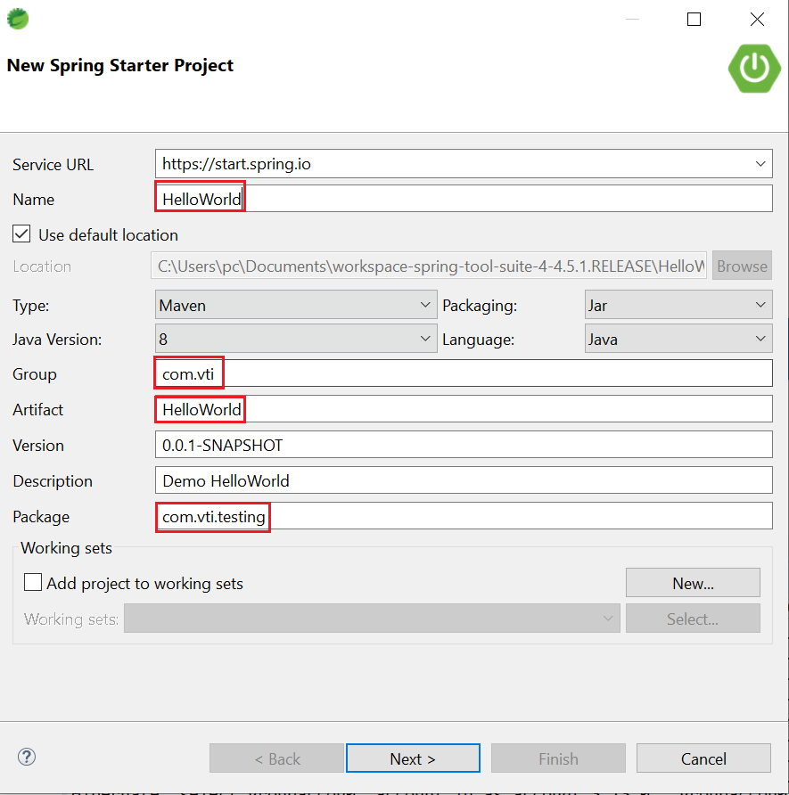
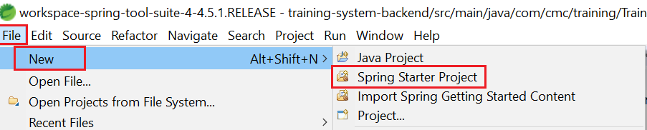
HelloWorld
Step 1: Create Spring Starter Project ➔ Install library

Slide 6
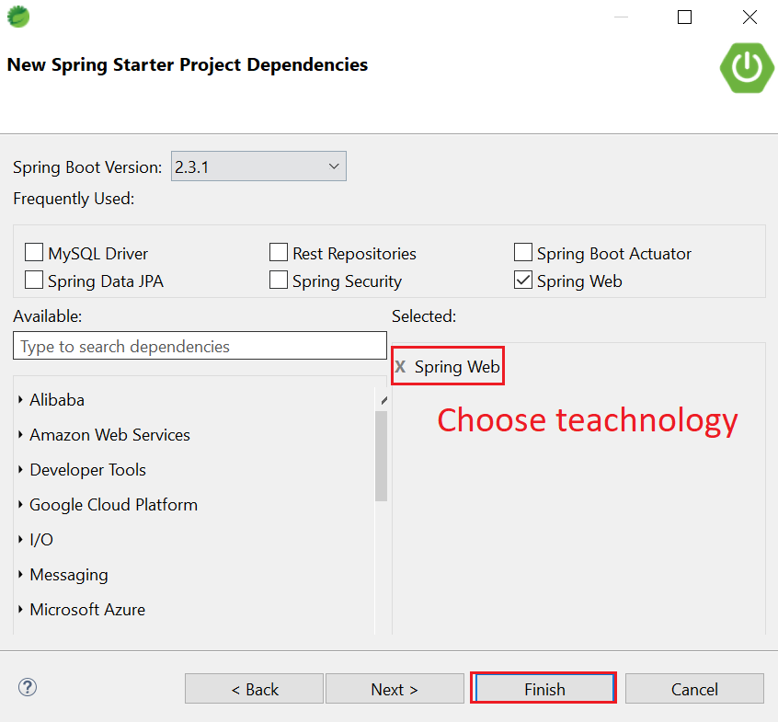
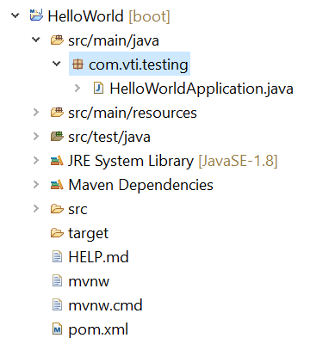
HelloWorld
Source code

Slide 7
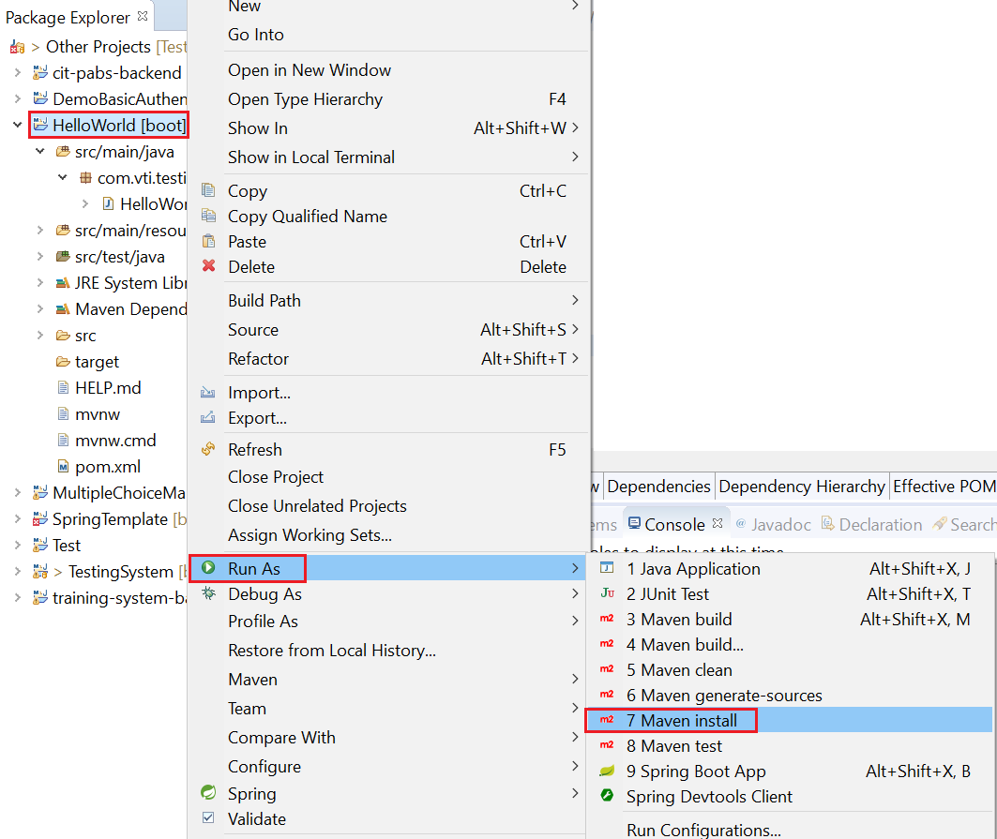
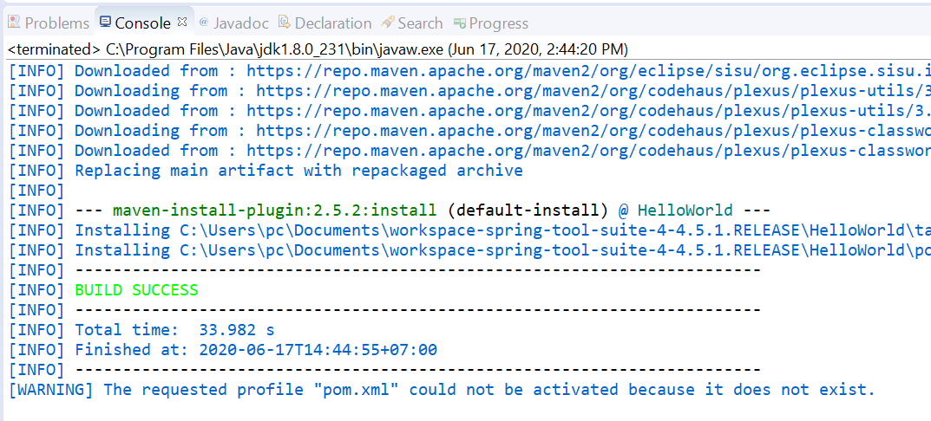
HelloWorld
Install library

Slide 8
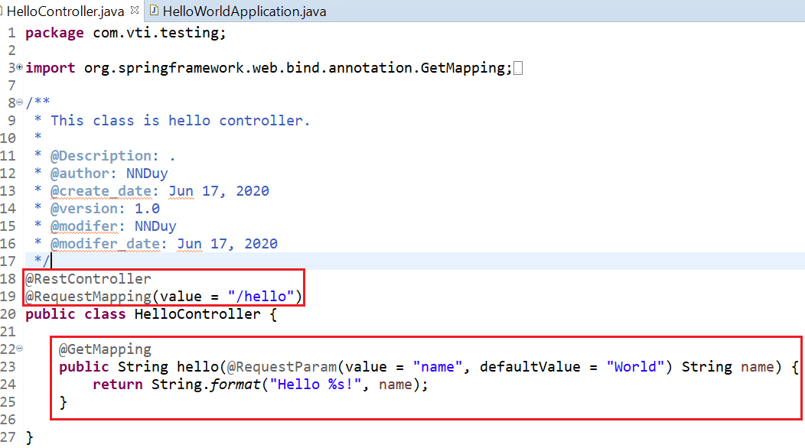
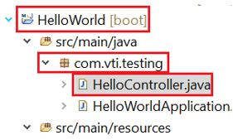
HelloWorld
Step 2: Create Controller file

Slide 9
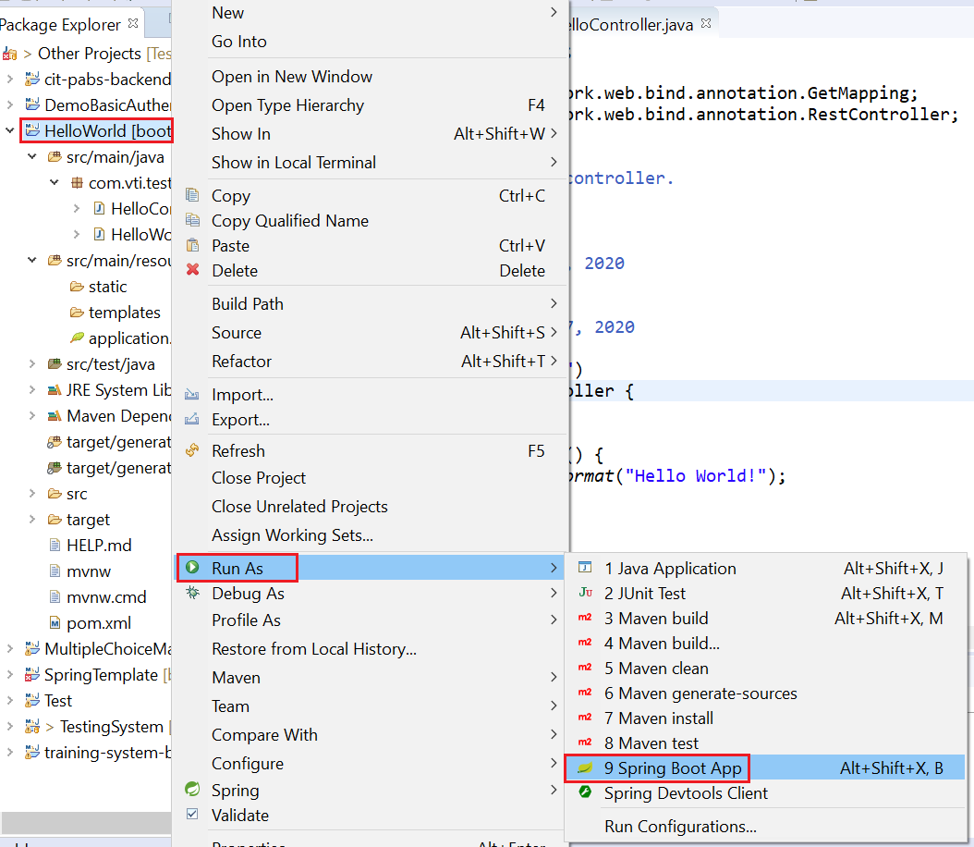
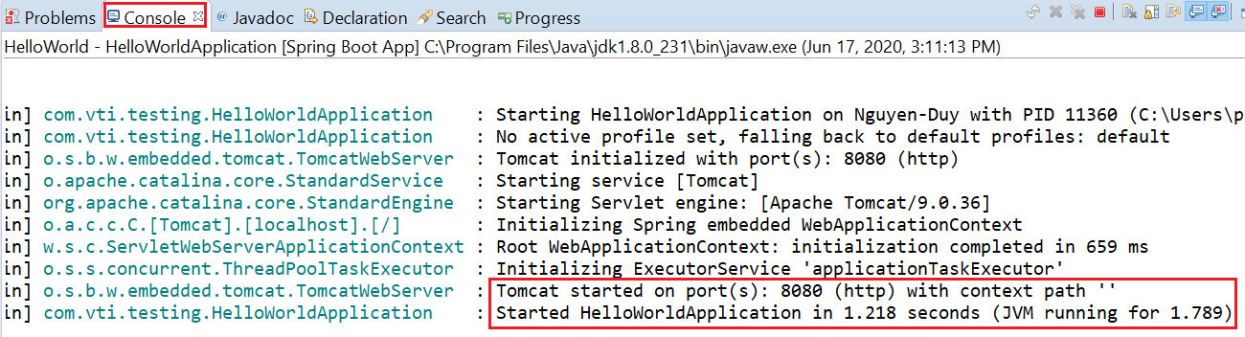
HelloWorld
Step 3: Start Server

Slide 10
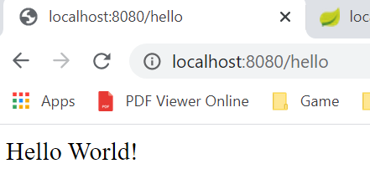
HelloWorld
Step 4: Access API
Tutorial: https://spring.io/quickstart

Slide 11
A few concepts
Web & Web service
JSON & XML
API & Restful API
HTTP

Slide 12
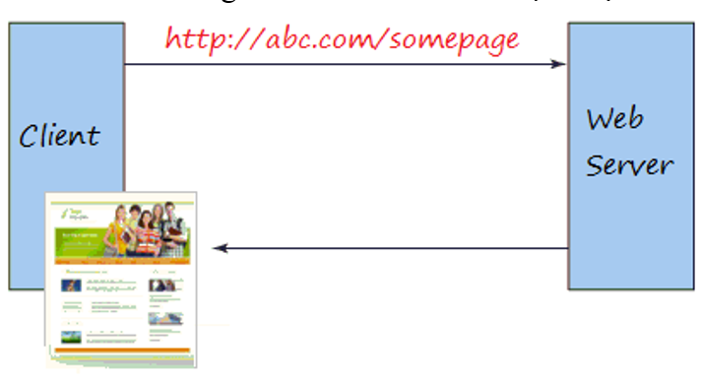
Web & Web Service
Web (Rarely, Old)
  Enter the URL and the Brower returns a web page that the user can read
  Ex: JSP & Servlet, Spring MVC
Web

Slide 13
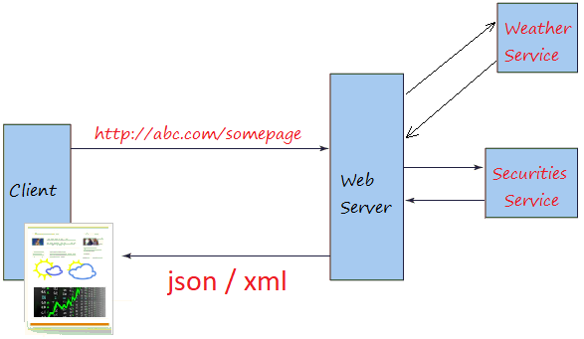
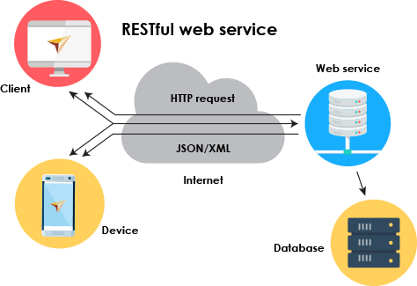
Web & Web Service
Web service
  Usually provide raw and confusing information for most users (usually return in JSON, XML)
  The backend can provide services to multiple frontend types (ex: mobile, web, tv, ...)
Web service
Multiple frontend types

Slide 14
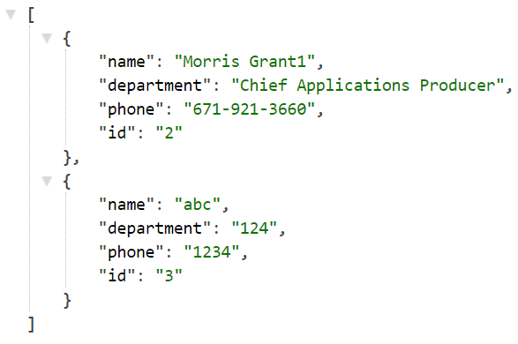
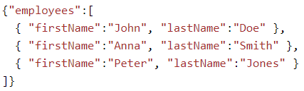
JSON & XML
JSON (JavaScript Object Notation)
  Doesn't use the tag ➔ shorter than XML ➔ quicker loading
  Using for sending data between 2 application
JSON

Slide 15
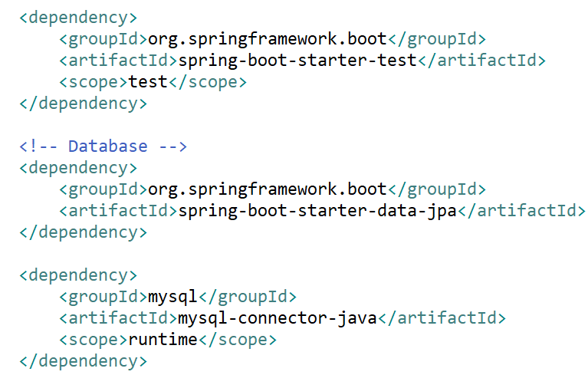
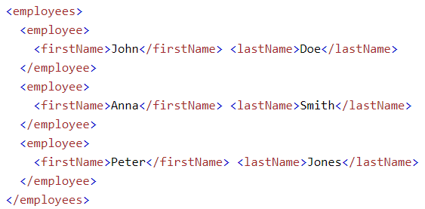
JSON & XML
XML
  Using for application configuration, html, css, ...
XML

Slide 16
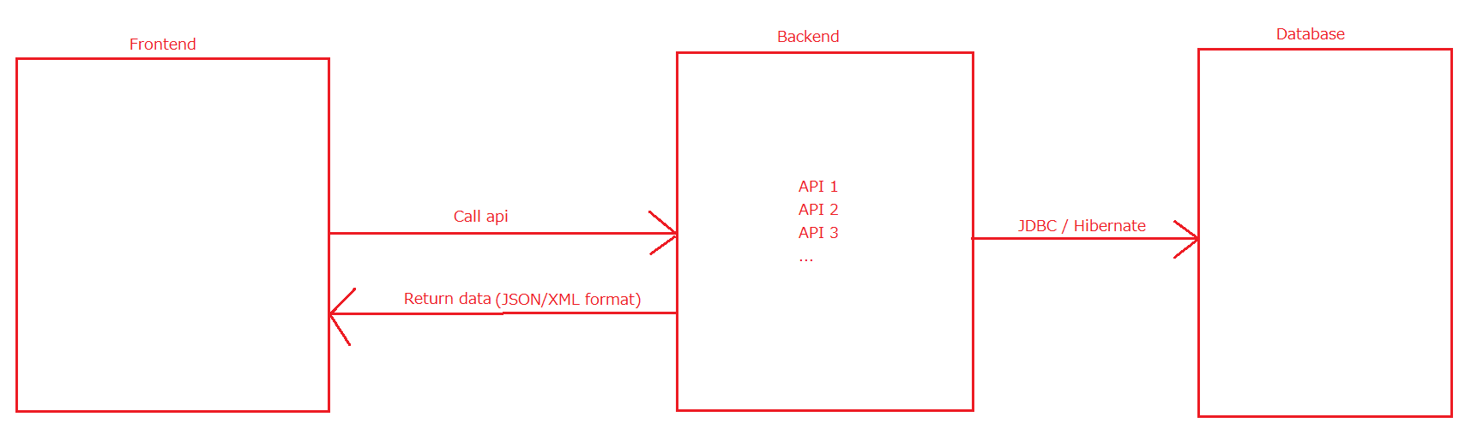
API & Restful API
API (Application Programming Interface)
  Using for transfer data between 2 application

Slide 17
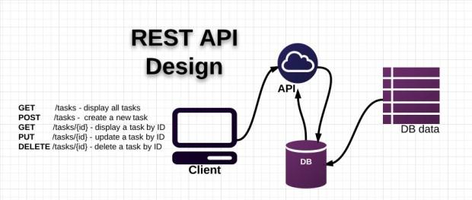
API & Restful API
Restful API
  is a standard used in designing APIs for web applications to manage resources

Slide 18

API & Restful API
Restful API design principles
  1. Use plural nouns, don't use verbs
  2. Use HTTP request method to separate User Action
    GET: for reading data
    POST: for creating data
    PUT: for updating data
    DELETE: for removing data

Slide 19

API & Restful API
Restful API design principles
  3. Use sub-resources
  4. Providing Paging, Sort, Filter, field Choosing

Slide 20
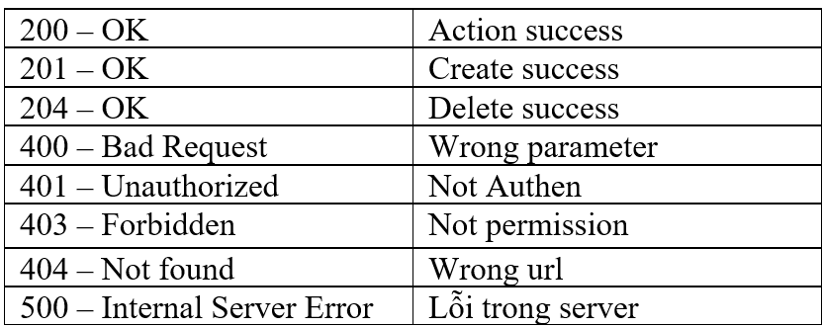
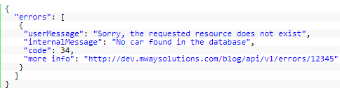
API & Restful API
Restful API design principles
  5. Providing version
  6. Handling Exception
Common Error

Slide 21
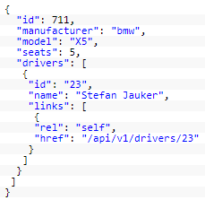
API & Restful API
Restful API design principles
  7. HATEOAS (Hypermedia as the Engine of Application State)

Slide 22
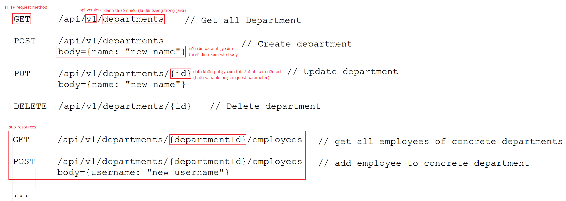
API & Restful API
Restful API design principles
  Example
Next Lesson: Designing for paging, sort, filter, handling error, HATEOAS

Slide 23
API & Restful API
Restful API design principles
  References
    https://www.laurencegellert.com/2016/08/webservice-api-design-tips-correct-pagination-and-exposing-deleted-rows/
    https://docs.microsoft.com/en-us/azure/architecture/best-practices/api-design

Slide 24
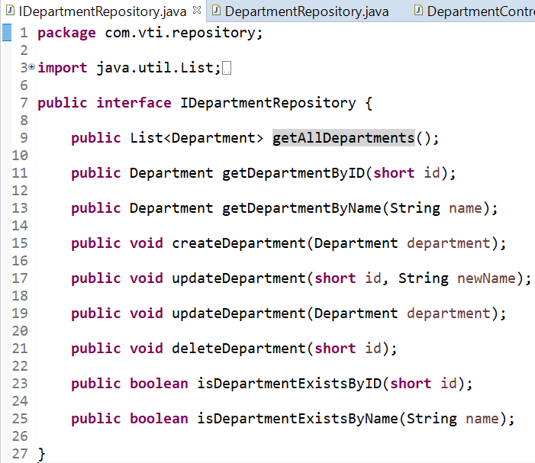
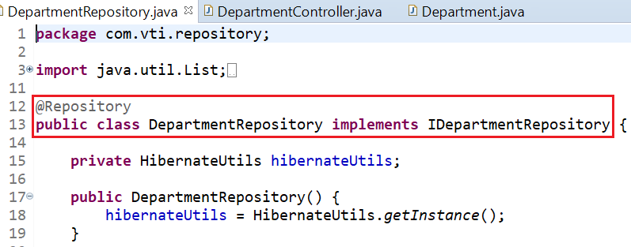
API & Restful API
Implement Restful API with 3 Layer Spring boot
Repository

Slide 25
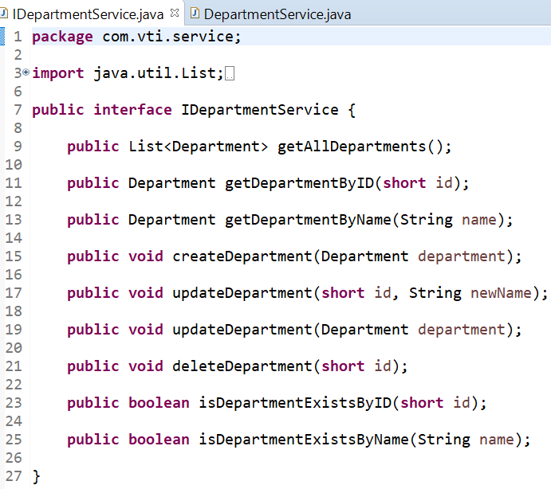
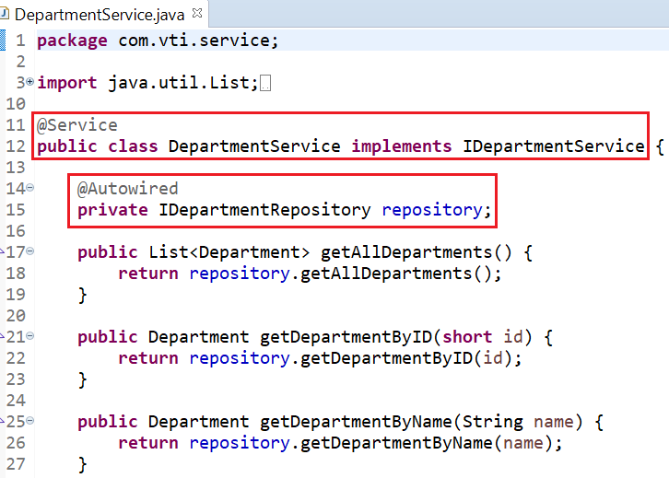
API & Restful API
Service

Slide 26
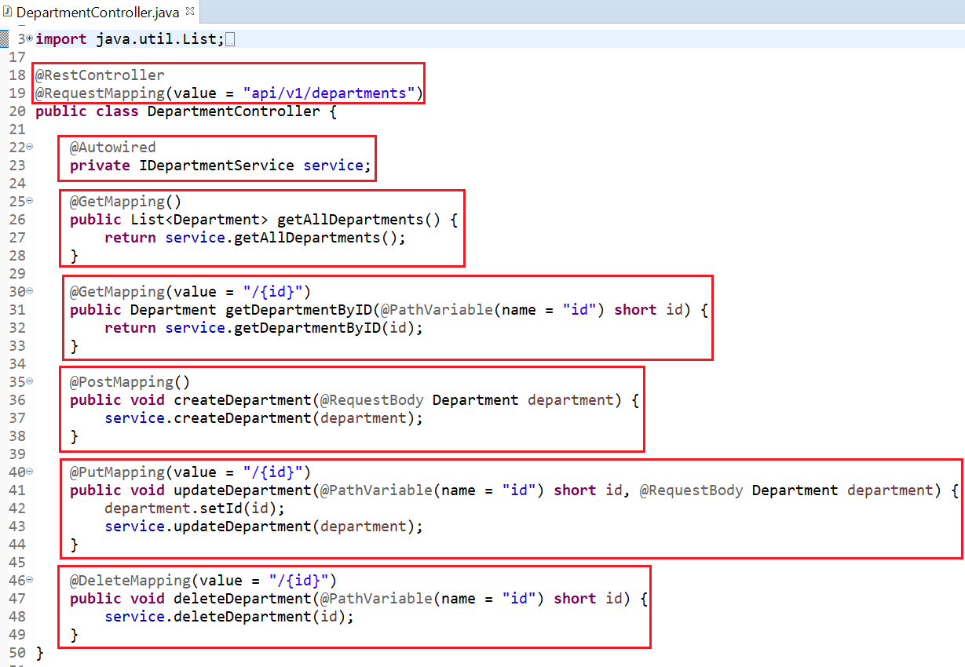
API & Restful API
Controller

Slide 27
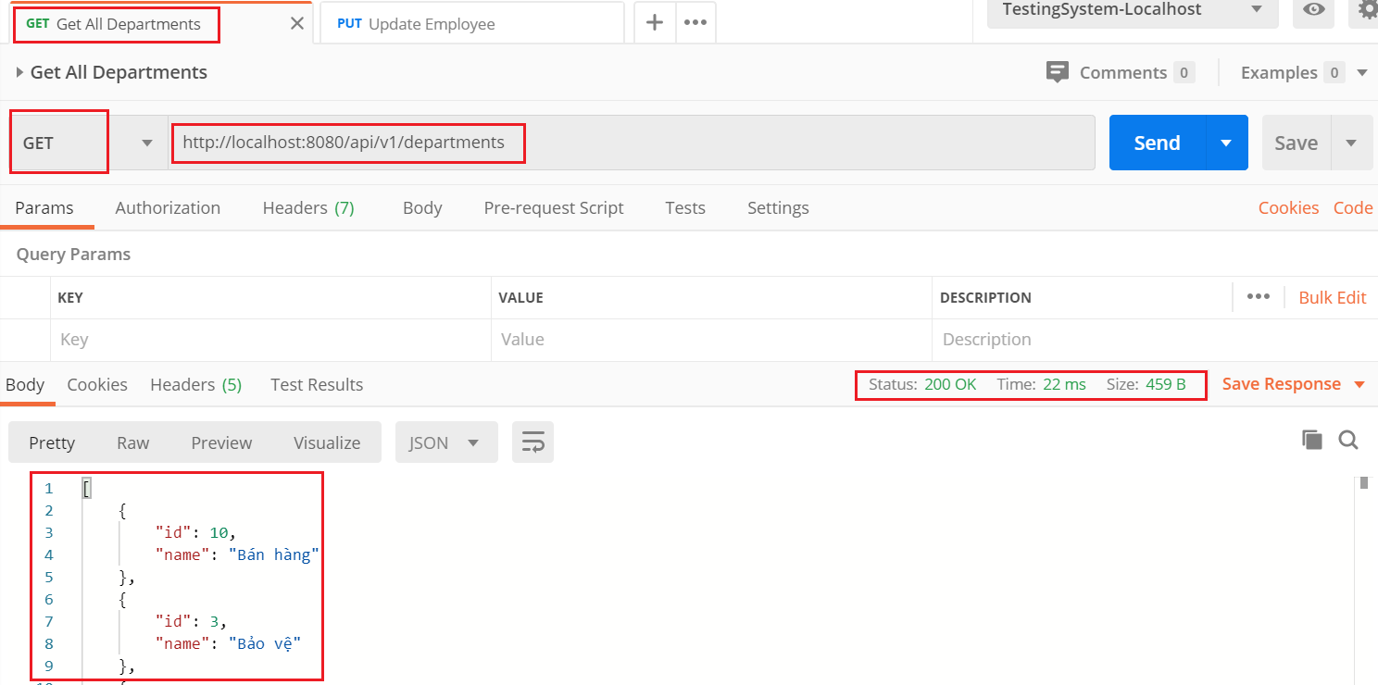
API & Restful API
Test (postman)
  https://www.postman.com/downloads
Get all

Slide 28
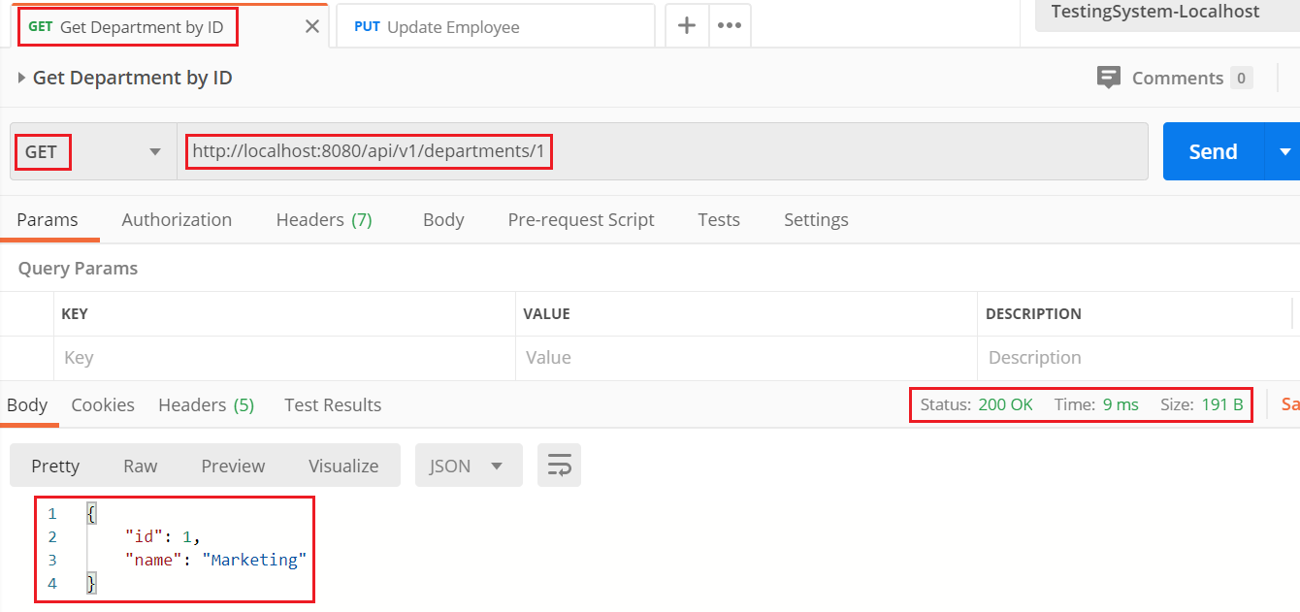
API & Restful API
Get by ID

Slide 29
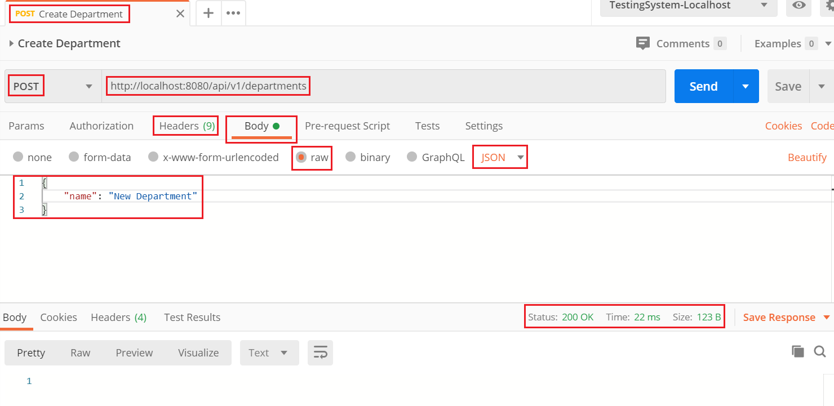
API & Restful API
Create

Slide 30
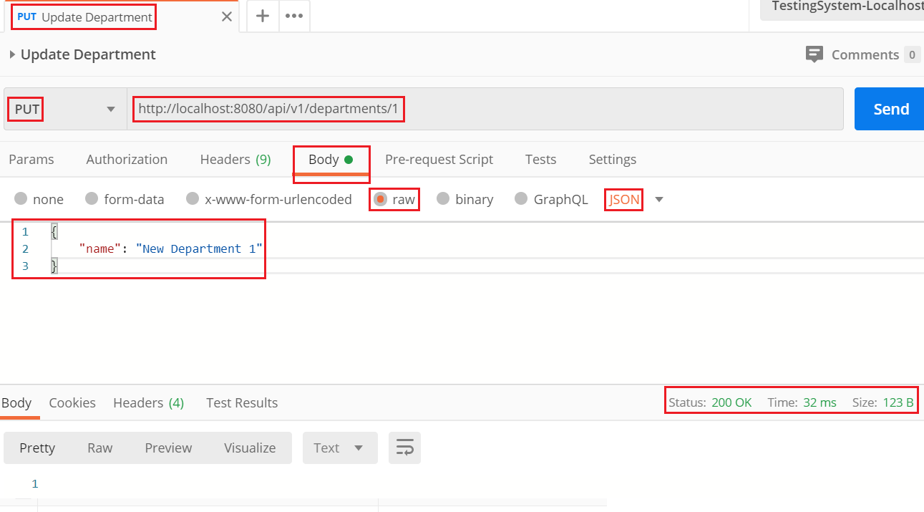
API & Restful API
Update

Slide 31
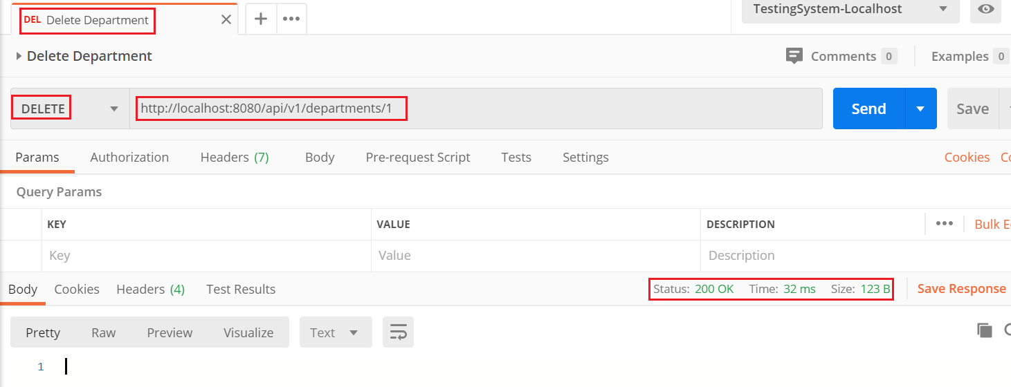
API & Restful API
Delete

Slide 32
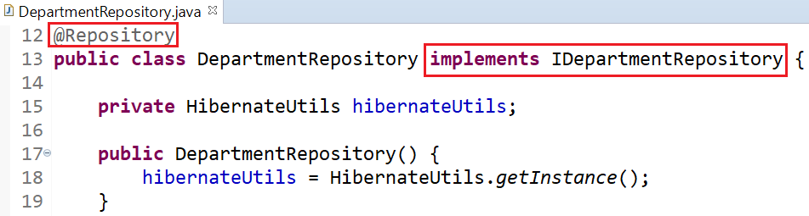
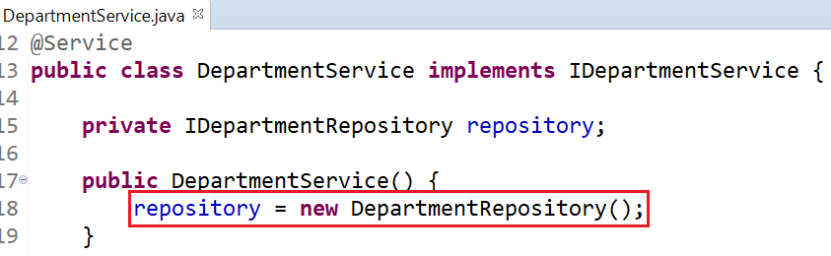
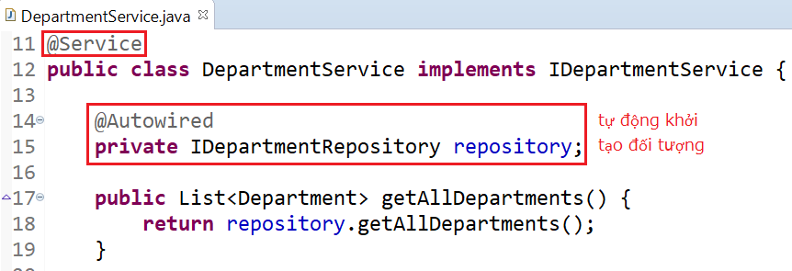
API & Restful API
Explain
@Autowired

Slide 33
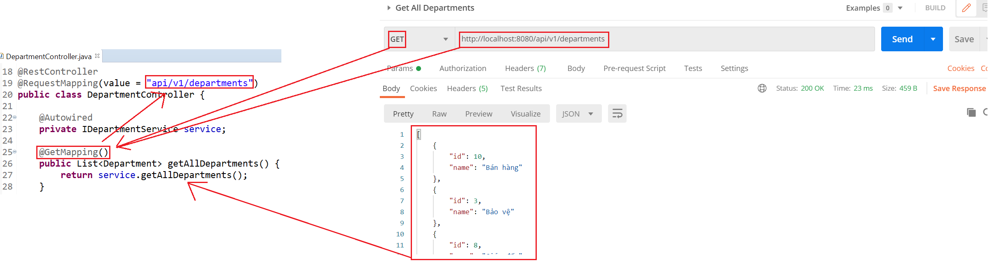
API & Restful API
@GetMapping & URL

Slide 34
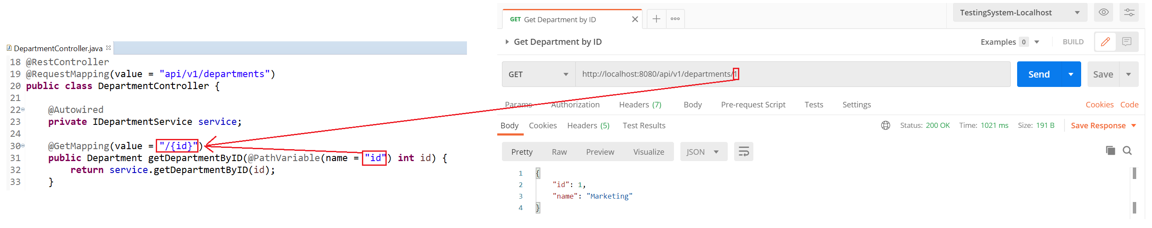
API & Restful API
@PathVariable

Slide 35
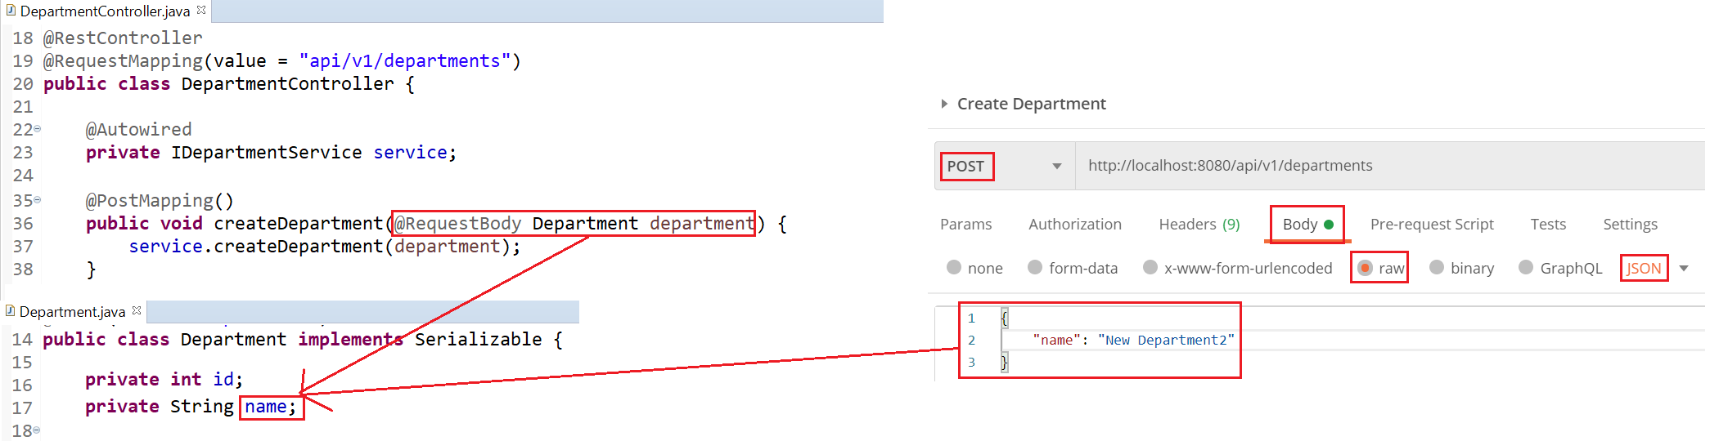
API & Restful API
@RequestBody

Slide 36
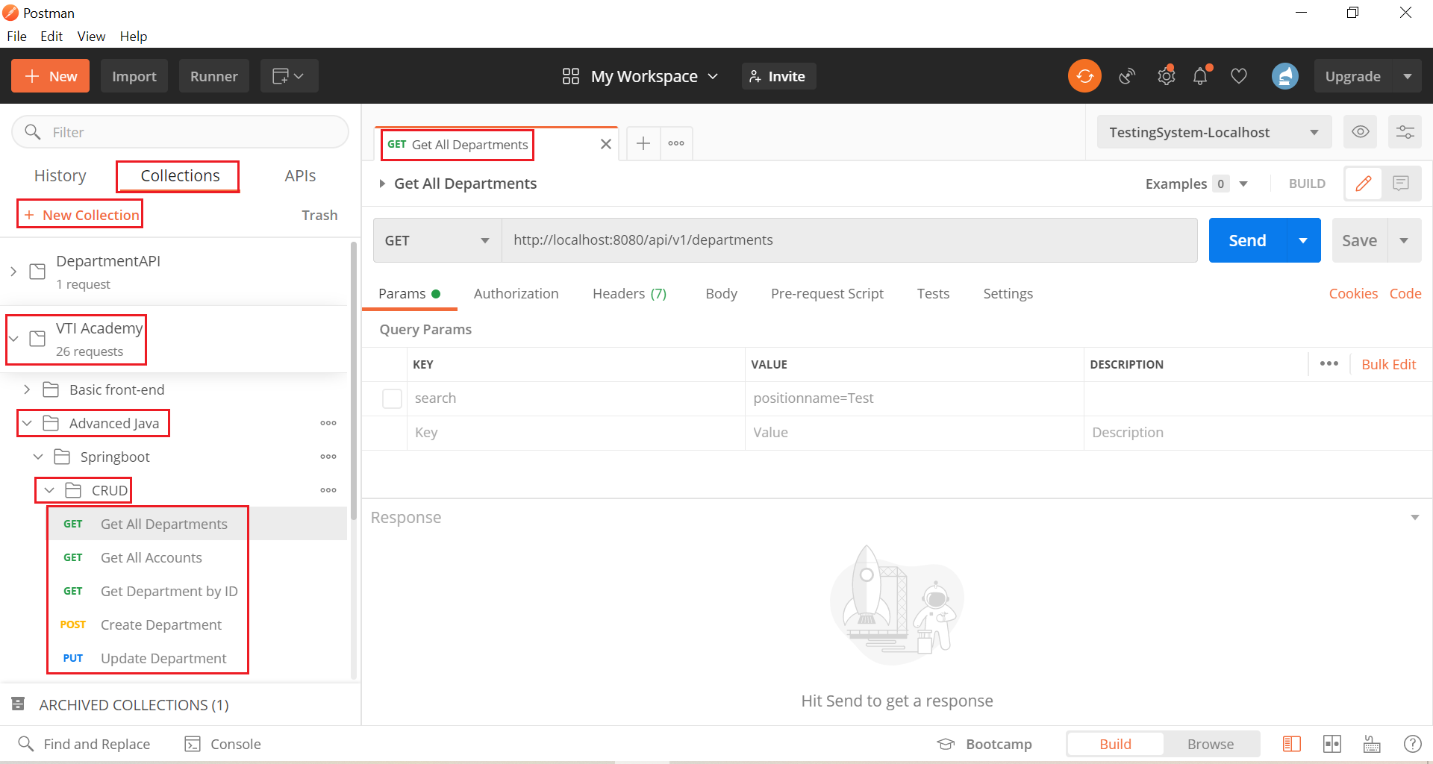
API & Restful API
Postman Organization

Slide 37
API & Restful API
Reference: https://spring.io/guides/gs/rest-service/

Slide 38
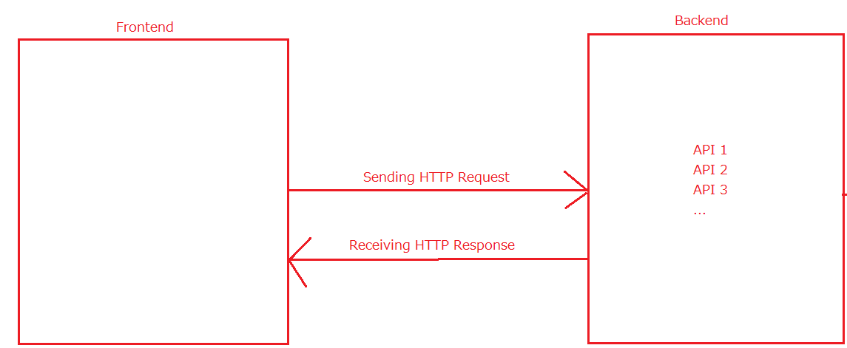
HTTP
HTTP Request
  Header (cookie, Authorization,…)
  Method (GET, POST, PUT, DELETE, ...)
  URL & Body
HTTP Response
  Header
  Status Code
  URL & Body

Slide 39
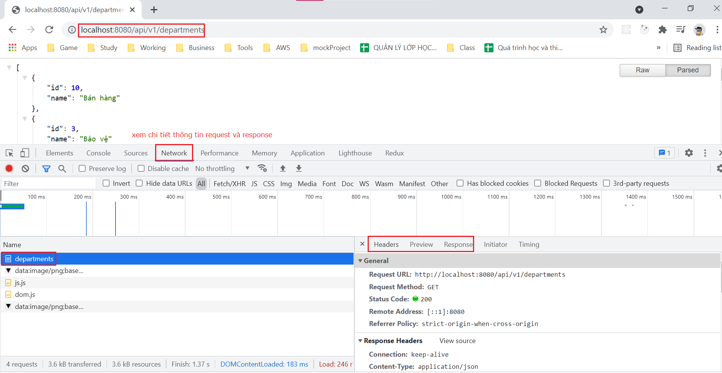
HTTP

Slide 40
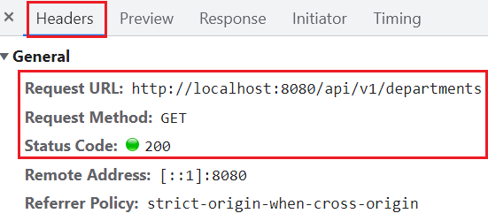
HTTP
HTTP Request Method
  GET: Get resource
  POST: create resource
  PUT: update resource
  DELTE: delete resource
Request

Slide 41
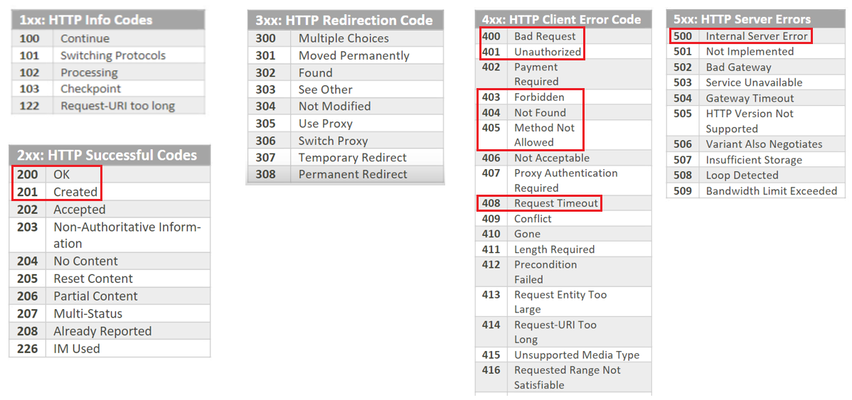
HTTP
HTTP Response Status Code

Slide 42
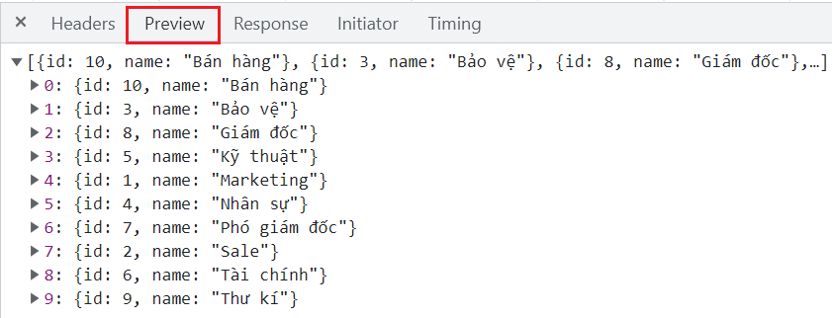
HTTP
Response Data

Slide 43
Reference
https://www.baeldung.com
https://spring.io/projects/spring-boot
https://spring.io/guides#getting-started-guides

Slide 44
Q & A
Copyright © VTI Academy All Rights Reserved

